Slide 1
Topic: Distributed Denial of Service using MySQL Relational database structure based on Network Security
Prepared by:
Rachana Mangalaram
Under the guidance of:
Zakir Hussain

Slide 2
Contents:
What is DDos?
DDoS Workflow
Types
Methods to launch DDoS Attacks
Solutions to protect against DDoS
Database used
MySQL Queries

Slide 3
What is DDoS?
A Distributed Denial of Service (DDoS) attack is designed to overcome a target (usually a server or network) with an excessive amount of traffic, rendering it slow or completely unavailable to legitimate users.
Attackers typically use a network of compromised devices (called a botnet) to flood the system with requests, exhausting the target's resources and crashing services.
This is one of the most common types of cyber-attacks, especially on large-scale public services such as websites, online applications, and cloud-based platforms.

Slide 4
Workflow of DDoS:
This slide outlines the step-by-step process of how DDoS attacks are carried out:
Botnet Creation: Attackers infect devices with malware, turning them into “bots” under their control. These infected devices form a botnet.
Traffic Generation: The attacker commands the botnet to send huge volumes of traffic to a targeted system or network.
Traffic Flood: The botnet floods the system with more requests than it can handle, overwhelming it with traffic.
System Overload: The targeted system becomes overwhelmed and either slows down significantly or completely shuts down, resulting in downtime for legitimate users.

Slide 5
Types of DDoS:
There are different types of DDoS attacks, and they can be classified into three main categories:
Volume-Based Attacks: These involve sending a massive volume of data to the target to exhaust its bandwidth. Examples include UDP floods and ICMP floods.
Protocol Attacks: These exploit weaknesses in network protocols, consuming server resources like memory or firewall states. Examples include SYN floods and Ping of Death.
Application-Layer Attacks: These target the application itself by sending legitimate-looking requests that consume application resources, making it unavailable for real users. Examples include HTTP floods and Slowloris attacks.

Slide 6
Methods to launch:
Attackers employ various techniques to carry out DDoS attacks:
Botnets: A network of compromised devices (such as computers, IoT devices) that work together to launch the attack.
Malware: Used to infect devices and make them part of the botnet.
Scripting: Automation tools are used to execute attack scripts that generate large-scale attacks.
Amplification Attacks: These involve sending a small request to third-party services (like DNS or NTP servers), which respond with large amounts of data directed at the target, amplifying the attack.

Slide 7
Solutions:
Firewalls: Used to block traffic from known malicious IPs and prevent access to the network.
Intrusion Detection/Prevention Systems (IDS/IPS): Monitor network traffic for suspicious activity and block potential attacks.
Load Balancers: Distribute incoming traffic across multiple servers to prevent any one server from being overwhelmed.
Content Delivery Networks (CDNs): Store and serve content from various locations globally to reduce the load on the target server.
DDoS Mitigation Services: Specialized services like Cloudflare or AWS Shield that detect and neutralize DDoS traffic before it reaches the target.

Slide 8
Database used:
MySQL is an open-source relational database management system (RDBMS) that allows you to store, manage, and retrieve data efficiently using Structured Query Language (SQL). It’s widely used in web applications due to its speed, reliability, and flexibility. MySQL is known for its scalability, handling everything from small to large databases. It supports ACID (Atomicity, Consistency, Isolation, Durability) properties, ensuring reliable transactions, and works across multiple platforms, including Linux, Windows, and macOS.
Version used is 8.4.1

Slide 9
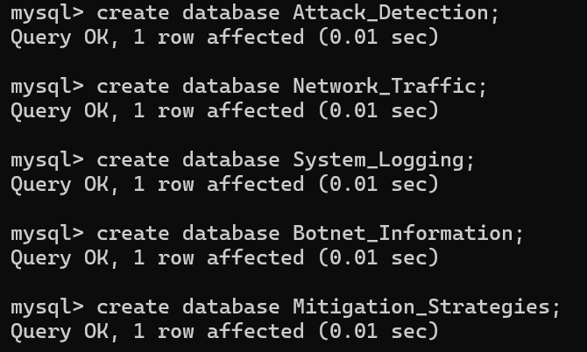
Execution:
To create the database:

Slide 10
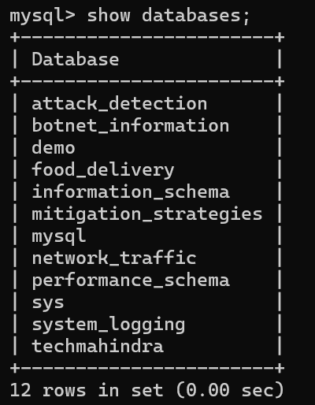
To display the created databases:

Slide 11

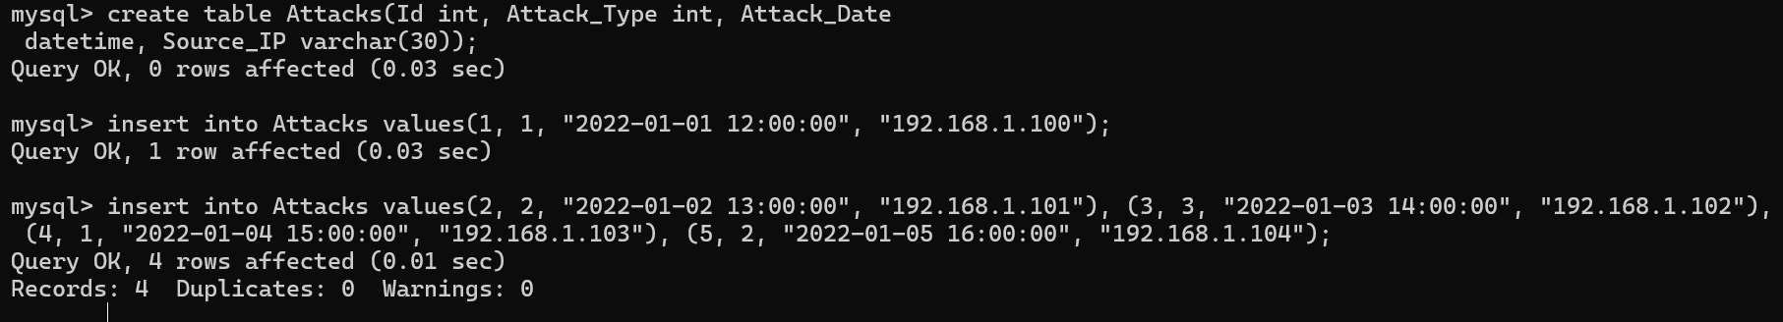
To use the database:
To create and insert the records in the table:

Slide 12
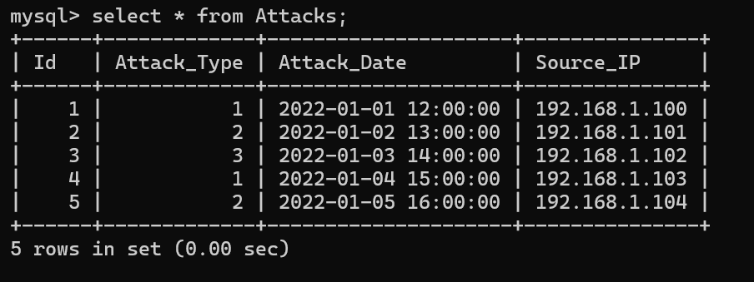
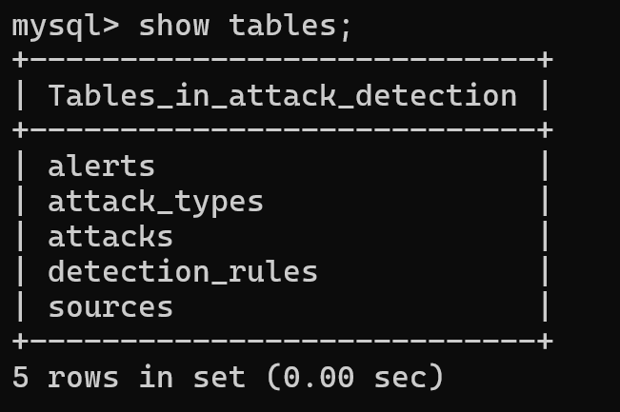
To display the records:
To list the tables in the database:

Slide 13
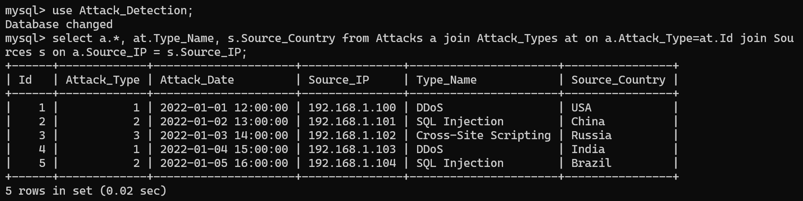
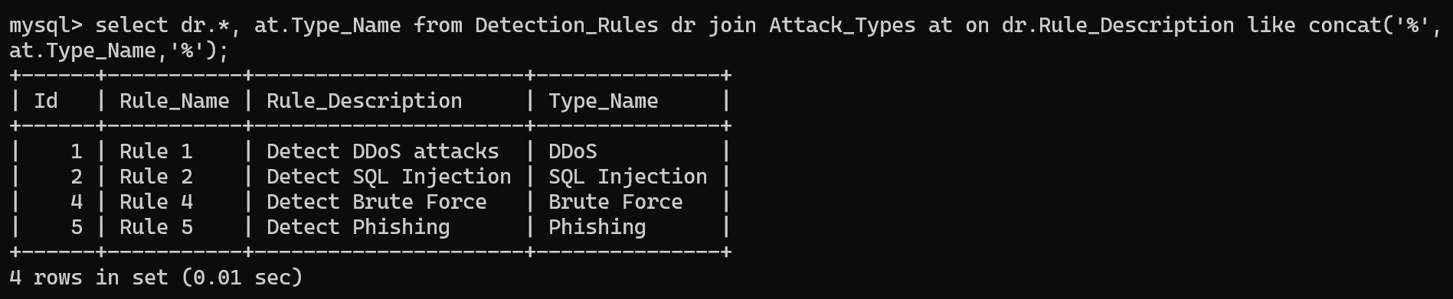
To retrieve all attacks with corresponding attack type and source information:
Retrieve all detection rules with corresponding attack type:

